Slide 1

Getting Started with Deep Learning
Notes:
Hello and welcome to this first presentation in the Practicum AI Deep Learning Foundations workshop series. I’m [[YOUR NAME HERE]], and I will act as your guide and mentor for this learning experience. I currently work as an AI Trainer / Consultant in the Research Computing Department at the University of Florida.
Let’s get started…

Slide 2
Deep Learning Foundations
Intermediate Series!
How to Tune Your Models
Deep Learning, Opening the Machine
Getting Started with Deep Learning
Notes:
Our Deep Learning Foundations series comprise 3 workshops. In this session and the next three which follow, we cover the basics of deep learning. Keep in mind that this series is the capstone for our Beginner track. This material assumes you know a bit about Python and are comfortable using Jupyter Notebooks and working inside HPC environments.

Slide 3
Module 1 Objectives
Define a neural network.
Describe how a neural network works.
Discuss what can be done with neural networks.
Discuss deep networks.
Use a deep learning pre-trained model to classify an image.
Discuss Python AI Frameworks.

Slide 4
What Are Neural Networks?

Slide 5
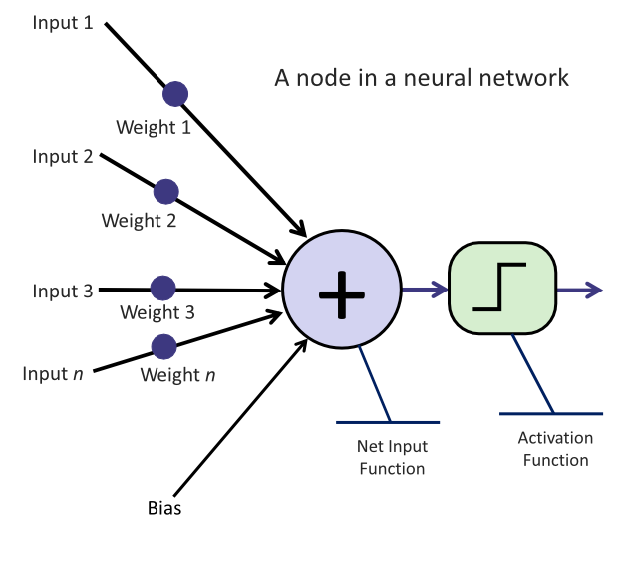
Introducing, The Node
Notes:
The core of deep learning is the neural network. A neural network is a particular learning algorithm inspired by the billions of interconnected neurons in the human brain. It consists of interconnected nodes (analogous to neurons) that process information in layers. Each connection has a weight, which gets adjusted during training, allowing the network to "learn" from data and make predictions. Each input connection is assigned a weight for each node (or neuron). The input value is multiplied by the weight, and all these products are added together. Each node also has a bias term that is added to the sum. That sum is the raw output of the neuron. Neurons can have an activation function, which modifies the output before passing it on to the next node in the network. Activation functions enable non-linear functions to be learned, and which function to use is one of the hyperparameters or model settings you can set in training.

Slide 6
Many Nodes Create a Network
Notes:
A neural network is a series of interconnected nodes that aim to transform input data into meaningful output. In practice, there are typically many (thousands) of neurons in layers, and each layer takes input from the previous layer in the network and feeds its output to the next layer.
Nodes or Neurons: These are the fundamental units of a neural network. Each node receives information, processes it, and then sends it onward. We'll go deeper into how exactly nodes work in the next module.
Layers: A typical neural network is organized into three main types of layers:
Input Layer: The first layer where data enters the system.
Hidden Layers: These are layers that sit between the input and output layers. The data undergoes multiple transformations as it passes through these layers. There can be one or many hidden layers in a network. The term hidden layer refers to the fact that we don't see the details of how they operate—while we see the input going in and the output coming out, we don't directly see the operations in the middle.
Output Layer: The final layer produces the result or prediction.
Weights: These are values associated with the connections between nodes. They determine the importance or influence of one node's output on another. During training, these weights are adjusted to minimize the difference between the network's predictions and the actual outcomes.
Activation Functions: Each node in the network has an associated activation function. It decides how the information the node has processed should be transformed before being passed forward. Think of it as a filter that amplifies, diminishes, transforms, or maintains the signal it receives.

Slide 7
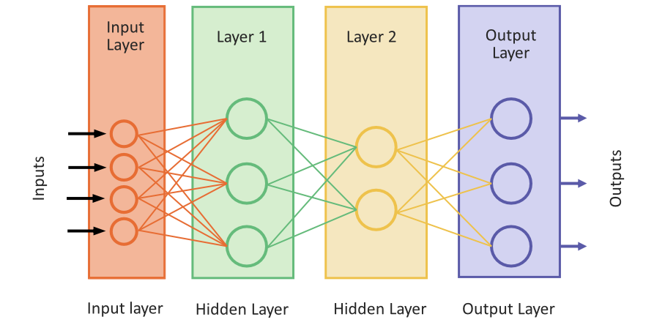
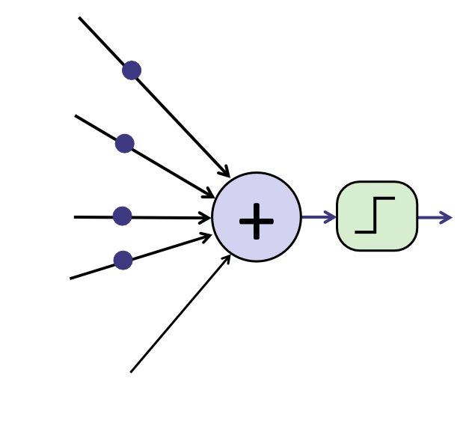
Many Nodes Create a Network
Notes:
A neural network is a series of interconnected nodes that aim to transform input data into meaningful output. In practice, there are typically many (thousands) of neurons in layers, and each layer takes input from the previous layer in the network and feeds its output to the next layer.
Nodes or Neurons: These are the fundamental units of a neural network. Each node receives information, processes it, and then sends it onward. We'll go deeper into how exactly nodes work in the next module.
Layers: A typical neural network is organized into three main types of layers:
Input Layer: The first layer where data enters the system.
Hidden Layers: These are layers that sit between the input and output layers. The data undergoes multiple transformations as it passes through these layers. There can be one or many hidden layers in a network. The term hidden layer refers to the fact that we don't see the details of how they operate—while we see the input going in and the output coming out, we don't directly see the operations in the middle.
Output Layer: The final layer produces the result or prediction.
Weights: These are values associated with the connections between nodes. They determine the importance or influence of one node's output on another. During training, these weights are adjusted to minimize the difference between the network's predictions and the actual outcomes.
Activation Functions: Each node in the network has an associated activation function. It decides how the information the node has processed should be transformed before being passed forward. Think of it as a filter that amplifies, diminishes, transforms, or maintains the signal it receives.

Slide 8
Many Nodes Create a Network
Notes:
A neural network is a series of interconnected nodes that aim to transform input data into meaningful output. In practice, there are typically many (thousands) of neurons in layers, and each layer takes input from the previous layer in the network and feeds its output to the next layer.
Nodes or Neurons: These are the fundamental units of a neural network. Each node receives information, processes it, and then sends it onward. We'll go deeper into how exactly nodes work in the next module.
Layers: A typical neural network is organized into three main types of layers:
Input Layer: The first layer where data enters the system.
Hidden Layers: These are layers that sit between the input and output layers. The data undergoes multiple transformations as it passes through these layers. There can be one or many hidden layers in a network. The term hidden layer refers to the fact that we don't see the details of how they operate—while we see the input going in and the output coming out, we don't directly see the operations in the middle.
Output Layer: The final layer produces the result or prediction.
Weights: These are values associated with the connections between nodes. They determine the importance or influence of one node's output on another. During training, these weights are adjusted to minimize the difference between the network's predictions and the actual outcomes.
Activation Functions: Each node in the network has an associated activation function. It decides how the information the node has processed should be transformed before being passed forward. Think of it as a filter that amplifies, diminishes, transforms, or maintains the signal it receives.

Slide 9
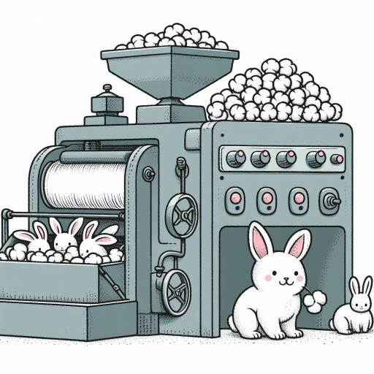
Gradual Improvement Over Time
Image generated using AI tools
Notes:
As an analogy, imagine a factory assembly line that takes raw input materials and has several stations where workers perform some function to produce a product. There is an example product that the workers aim to replicate. Each station (a node or neuron) in our factory has a specific task. Raw materials (input data) are entered at the beginning, and each station makes slight modifications. By the time the materials reach the end of the assembly line, they've been transformed into a finished product (output or prediction). The product of the assembly line is then compared to the example product. The factory workers then adjust their tools or methods by comparing outputs to the ground truth to produce better products. Similarly, a neural network adjusts its weights based on the difference between its predictions and the actual outcomes, improving its accuracy over time.

Slide 10
What is Deep Learning?

Slide 11

Imagine You’re Making a Cake…
Input(s)
Output
Hidden Layers
Notes:
Imagine you're making a multi-layered cake, like a towering wedding cake. Each layer of the cake represents a layer in a neural network. Imagine you're making a multi-layered cake, like a towering wedding cake. Each layer of the cake represents a layer in a neural network. Now, "deep learning" is like our multi-layered wedding cake. Instead of one layer, we have many, many layers stacked on top of each other. Each layer contributes to the overall flavor and structure of the cake. In neural networks, having multiple layers allows for more complex transformations of the input data, enabling the network to understand intricate patterns and details.
Why is depth important? Well, just as each layer of our cake can have a different flavor or texture, adding depth (or layers) to our network allows it to capture distinctive features and nuances in the data. For instance, in image recognition, initial layers might identify simple patterns like edges or colors, while deeper layers could recognize more complex features like shapes, and even deeper layers might identify objects or scenes. There are different hidden layer "recipes" for each kind of deep learning application (image recognition would use different stacks of layers than natural language processing, for example).

Slide 12
What Can I Do with Neural Networks?

Slide 13
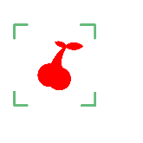


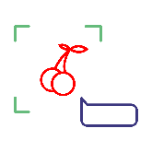
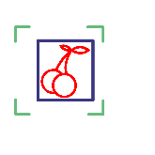





Example Neural Network Applications
Natural Language Processing
Computer Vision
Generative Methods
Time Series Analysis
Notes:
At this point, you might be thinking, "Neat! But uh… What would I use neural networks for?" Here is a list of some of the more popular tasks that neural networks are used for. You can do many more things with neural networks, with the limit mainly being your imagination and access to large, clean datasets. Network architectures are constantly changing as technology improves, so don't be confused if some of these are outdated by the time you take this course!

Slide 14
Types of Networks

Slide 15


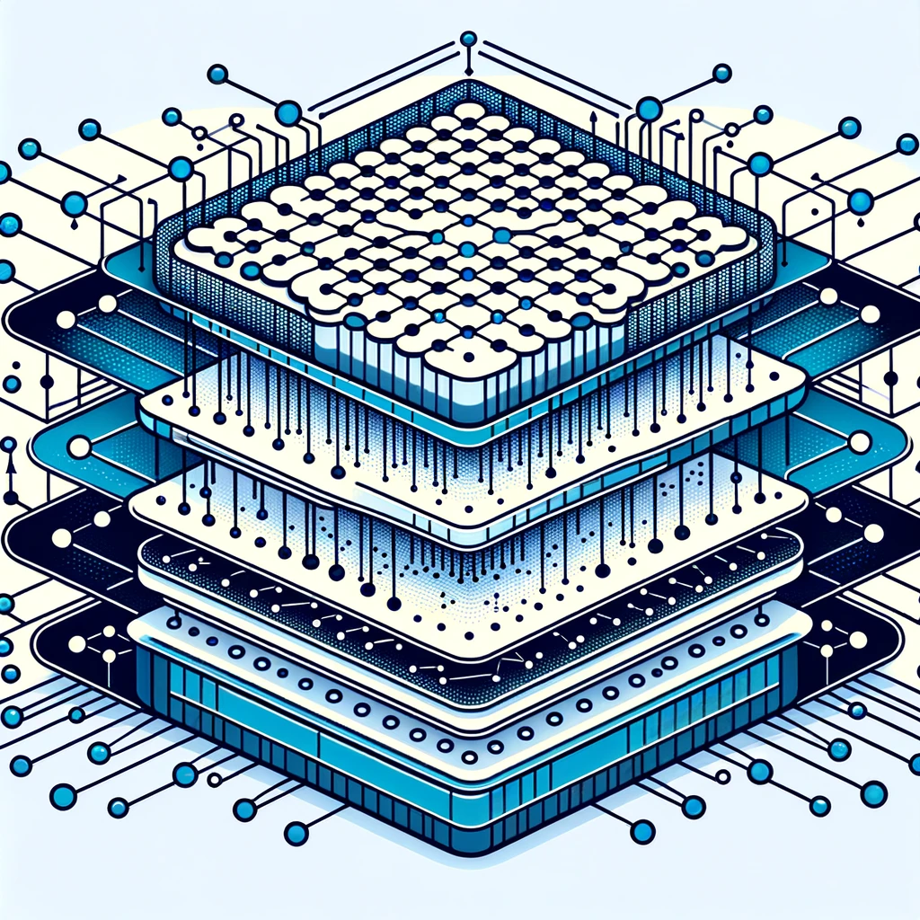
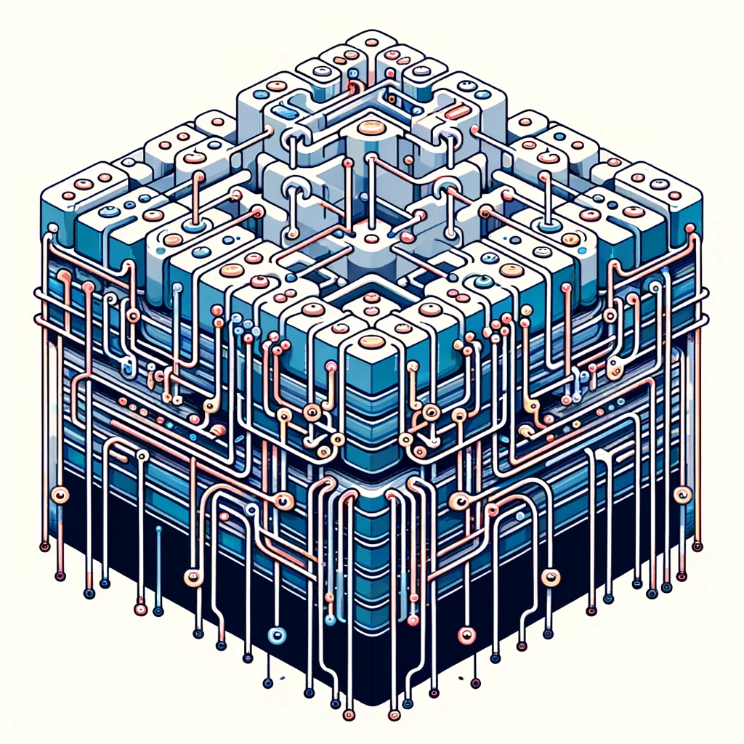

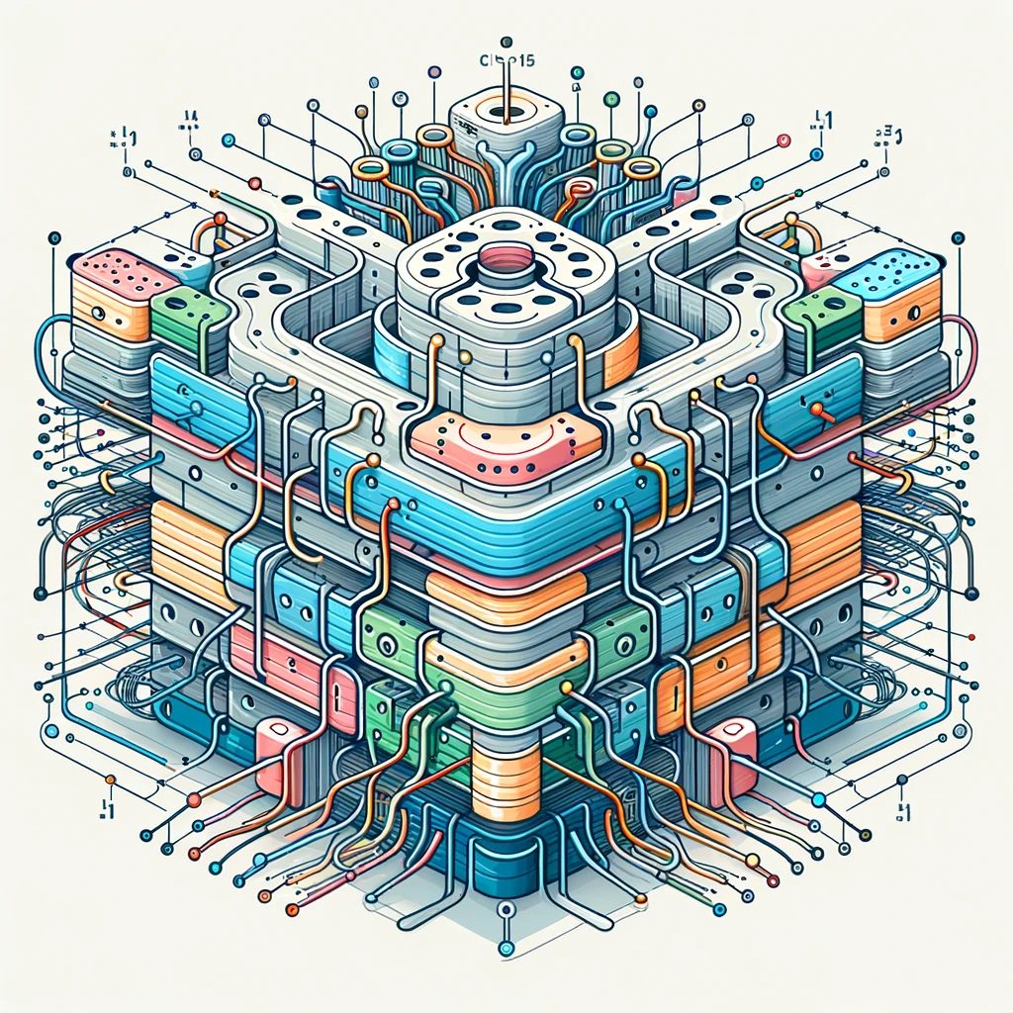

Example Network Architectures
CNN
GAN
LSTM
Stable Diffusion
cGAN
Transformer
RNN
All images on this slide were generated using AI tools
Notes:
This is just a very small list of architectures. There are now an enormous number of derivatives of each of these architectures, and novel network architectures are created all the time!

Slide 16










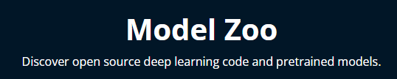


A Word on Model Zoos
Notes:
If you're interested in the latest model designs or the kinds of tasks being performed with AI, a model zoo would be the place to look. Model zoos are a repository of pre-trained machine learning models—these are almost like cookbooks. Find and use a good recipe or adapt it to your needs! Instead of building and training a model from scratch, which can be time-consuming and resource-intensive, researchers and developers (like you!) can visit a model zoo to find a model that suits their needs.

Slide 17
Python AI Frameworks
Notes:
libraries like Pandas and NumPy make using Python for specific tasks more manageable. As AI applications were being developed, coders built frameworks (which can be considered extensive collections of libraries that enable complex tasks—like doing AI research) to facilitate their AI research. The most common frameworks are PyTorch and TensorFlow. Keras started as an easy-to-use framework for interacting with other frameworks. At one time, it focused on TensorFlow, but as of version 3, released in Fall 2023, it now supports TensorFlow, PyTorch, and JAX.

Slide 18


Which Framework to Use?
Framework | Initial Release | Focus
 | September 2016 | General deep learning library
 | November 2015 | General deep learning library
 | March 2015 | Easy-to-use interface to TensorFlow, but the latest version now also provides an interface to PyTorch and Jax.
(Jax) | May 2022 | Speeding up some parts of model training and providing easy scaling across multiple GPUs
Notes:
This is a challenging question to answer. At Practicum AI, we generally find Keras/TensorFlow easier to learn, which is what our courses will focus on. As Keras continues to develop support for TensorFlow, we feel this will continue to make it the easiest and best option for getting started.
PyTorch is generally easier to work with if you want complete control of how your model is implemented and trained. At the same time, TensorFlow is usually easier when using the most common methods and settings. With the more extended support of Keras, which makes deep learning even more accessible from the user perspective (though again, sacrificing some fine-grained control), TensorFlow has the reputation of being the more accessible Framework to get started in.

Slide 19
A Vision Quest
01_deep_learning_tour.ipynb
This notebook will walk you through instantiating a pre-trained vision model and testing it against new images!

Slide 20
Questions?
(QR CODE FOR SURVEY!)

